Slide 1
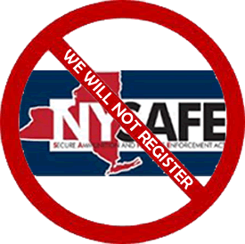
WE WILL NOT COMPLY
VERSION DATE 2/11/13

Slide 2

NY UN-SAFE
Slides with the NSSF.org Logo, made with information provided by the NSSF.
VERSION DATE 2/11/13

Slide 3

NY UN-SAFE
Slides with OCShooters.com logo made with information from NY Penal law sections:
  Article 70, SENTENCES OF IMPRISONMENT
  Article 265, FIREARMS AND OTHER DANGEROUS WEAPONS
  Article 400, LICENSING AND OTHER PROVISIONS RELATING TO FIREARMS
VERSION DATE 2/11/13

Slide 4
NY UN-SAFE
THE INFORMATION CONTAINED IN THIS POWER POINT PRESENTATION DOES NOT REPRESENT LEGAL ADVICE.
You are responsible for knowing and complying, (if you don’t believe in the 2nd amendment,) with all NY laws. All of these laws are new and subject to new legislative changes and corrections. Interpretation and implementation of all of the new laws has just started.
VERSION DATE 2/11/13

Slide 5
NY UN-SAFE
New laws are being written at this time to make corrections to the new laws. Additional laws will be voted on. Many court cases will be brought challenging several sections of the law. Please join the New York State Rifle And Pistol Association, SCOPE, the NRA and other groups supporting law suits to overturn this new law.
VERSION DATE 2/11/13

Slide 6
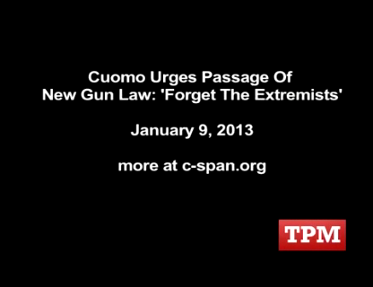

Slide 7
Expanded ban on “assault weapons”
Rifles, shotguns and handguns with certain characteristics are defined to be assault weapons, including semi--automatic rifles with detachable magazines and one military style feature. New York State previously banned assault weapons using a "two--feature" test taken from the now--‐expired federal assault weapons ban. The NY SAFE Act also expands the definition to include pistols and shotguns with certain proscribed features.

Slide 8
The NY SAFE Act:
Bans the in--‐state acquisition of assault weapons, effective as of January 15, 2013.
Grandfathers the prior ownership of assault weapons, but requires that they be registered with the State by April 15, 2014 and recertified every five years. Registration and recertification of grandfathered ownership will be subject to review by the New York State Police for “disqualifiers” which have not yet been defined.

Slide 9
The NY SAFE Act:
Requires that owners of grandfathered assault weapons may only sell these firearms out--‐of--‐state or through an in--‐state licensed dealer. Assault weapons cannot be inherited.
While the NY SAFE Act broadens the definition of assault weapon, it does not affect the exemptions for the possession of an assault weapon that were previously in place for certain persons and entities including police officers, manufacturers and licensed dealers.

Slide 10
Magazine capacity
Effective April 15, 2013, only magazines that contain seven rounds of ammunition or less can be sold in New York. Magazines that can hold more than seven rounds but not more than ten rounds and are currently possessed will be grandfathered, but may only be loaded with seven rounds.

Slide 11
Magazine capacity
By January 15, 2014, magazines that have the capacity to hold more than ten rounds of ammunition that were grandfathered by 1994 legislation must be discarded or sold to a licensed dealer or an out--‐of--‐state purchaser. Exceptions are made for large capacity magazines that are curios or relics. (More than 50 years old.)

Slide 12
Magazine capacity
Exemptions to allow manufacturers, licensed dealers and police officers to possess large capacity magazines continue to apply, except for an apparent drafting error in the NY SAFE Act that can read to prohibit anyone from possessing a magazine that is loaded with more than seven rounds. The exemption provided by Penal Law §265.20(a)(8) for manufacturers of “large capacity ammunition feeding devices”, etc. was unchanged, so that Section 265.02(8), which makes possession of a “large capacity ammunition feeding device” a class D felony wouldn’t apply to a manufacturer, even though the definition of a “large capacity ammunition feeding devices” has been expanded.

Slide 13
Magazine capacity
This would be the end of the discussion except that the SAFE Act added two new sections banning certain magazines that are not exempted by Section 265.20:
  Penal Law § 265.36: Makes it a class A misdemeanor to knowingly possess a “greater than ten” magazine manufactured before 9/13/1994, if owned before 1/15/2013.

Slide 14
Magazine capacity
  Penal Law § 265.37: Makes it a class A misdemeanor to knowingly possess an “ammunition feeding device” that was possessed before 1/15/2013 if it has a capacity of “more than seven but less than ten” if loaded with more than seven.
Penal Law § 265.37 could conceivably apply to a manufacturer, if rounds are put in a pre--‐1/15/2013 magazine. Police officers have the same issue.

Slide 15
Ammunition Sales
Effective January 15, 2014, sellers of ammunition must (1) register with the New York State Police, (2) run any buyer through a State--‐created review of disqualifiers to ensure that the buyer is not prohibited by law from possessing ammunition, and (3) keep records of sales that are electronically accessible to the State. The NY SAFE Act also bans direct internet sales of ammunition.

Slide 16
Database for Universal
Background Checks
The NY SAFE Act mandates a statewide license and record database to be run by the New York State Police, to become effective on January 15, 2014. This will require individuals who own a handgun or an assault rifle to recertify their permit every five years through their county of residence.

Slide 17
Database for Universal
Background Checks
This database will enable checks against other databases containing the names of people who should be disqualified from possessing firearms, including those with criminal convictions, involuntary commitments, and those subject to orders of protection, as well as death records.

Slide 18
Private Firearm Sales
The NY SAFE Act extends required background checks to all gun sales, effective March 15, 2013. All gun transfers between private parties, except immediate family, must be made through a federal firearms licensee, subject to a federal National Instant Criminal Background Check, subject to a maximum fee of $10.

Slide 19
Mental Health Alerts
The NY SAFE Act requires mental health professionals to report to local mental health officials when there is reason to believe a patient is likely to engage in conduct that will cause serious harm to themselves or others. This information will then be crosschecked against the new firearm registration database. If the patient possesses a firearm, the license will be suspended and law enforcement will be authorized to remove the person's firearm.

Slide 20
Increased Criminal Penalties
The NY SAFE Act increases penalties for certain firearm--‐related crimes, including for the murder of a first responder or for possession of a firearm on school grounds or on a school bus.
This summary was provided to NSSF courtesy of the Renzulli Law Firm, of White Plains, NY.

Slide 21
REPORT OF THEFT OR LOSS OF A FIREARM, RIFLE OR SHOTGUN.
Any owner or other person lawfully in possession of: (II) AMMUNITION AS WELL AS A FIREARM, RIFLE OR SHOTGUN WHO SUFFERS THE LOSS OR THEFT OF SUCH AMMUNITION AS WELL AS A FIREARM, RIFLE OR SHOTGUN; …
shall within twenty four hours of the discovery of the loss or theft report the facts and circumstances of the loss or theft to a police department or sheriff's office.

Slide 22
7 ROUND RULE
265.37 Unlawful possession of certain ammunition feeding devices. It shall be unlawful for a person to knowingly possess an ammunition feeding device that such person lawfully possessed before the effective date of the chapter of the laws of two thousand thirteen which added this section, that has a capacity of, or that can be readily restored or converted to accept more than seven but less than ten rounds of ammunition, where such device contains more than seven rounds of ammunition.

Slide 23
7 ROUND RULE
If such device containing more than seven rounds of ammunition is possessed within the home of the possessor, the person so possessing the device shall, for a first offense, be guilty of a violation and subject to a fine of two hundred dollars, and for a second offense, be guilty of a class B misdemeanor and subject to a fine of two hundred dollars and a term of up to three months imprisonment.

Slide 24
7 ROUND RULE
If such device containing more than seven rounds of ammunition is possessed in any location other than the home of the possessor, the person so possessing the device shall, for a first offense, be guilty of a class B misdemeanor and subject to a fine of two hundred dollars and a term of up to six months imprisonment, and for a second offense, be guilty of a class A misdemeanor. Effective March 16, 2013

Slide 25
7 ROUND RULE
265.20 Exemptions. a. Sections 265.01, 265.02, 265.03, 265.04, 265.05, 265.10, 265.11, 265.12, 265.13, 265.15 and 270.05 shall not apply to:
7-f. Possession and use of a magazine, belt, feed strip or similar device, that contains more than seven rounds of ammunition, but that does not have a capacity of or can readily be restored or converted to accept more than ten rounds of ammunition, at an indoor or outdoor firing range

Slide 26
7 ROUND RULE
located in or on premises owned or occupied by a duly incorporated organization organized for conservation purposes or to foster proficiency in arms; at an indoor or outdoor firing range for the purpose of firing a rifle or shotgun; at a collegiate, olympic or target shooting competition under the auspices of or approved by the national rifle association; or at an organized match sanctioned by the International Handgun Metallic Silhouette Association.

Slide 27
IMPORTANT DATES
January 15, 2013. AW BAN AND NEW AW DEFINITION, ONE FEATURE
March 15, 2013 NICS CHECK ON ALL GUN SALES EXCEPT BETWEEN IMMEDIATE FAMILY MEMBERS (SPOUSES, DOMESTIC PARTNERS, CHILDREN AND STEP-CHILDREN.)
April 15, 2013
  ONLY MAGAZINES THAT CONTAIN SEVEN ROUNDS OF AMMUNITION OR LESS CAN BE SOLD
  MAGAZINES CAN ONLY BE LOADED WITH SEVEN ROUNDS.

Slide 28
IMPORTANT DATES
January 15, 2014
  MAGAZINES THAT HOLD MORE THAN 10 ROUNDS ARE ILLEGAL TO POSSESS
  AMMUNITION SELLERS MUST BE REGISTERED
  BACKGROUND CHECK FOR ALL AMMUNITION SALES. NO DIRECT INTERNET SALES. (COULD BE SOONER)
April 15, 2014 ALL AWs MUST BE REGISTERED

Slide 29
PENALTIES
§ 265.01-b Criminal possession of a firearm (failure to register an Assault Weapon) is a class E felony, less than one year and up to four years.
§ 265.36 Unlawful possession of a, (pre 1994,) large capacity ammunition feeding device is a class A misdemeanor. Sentence of imprisonment shall not exceed one year

Slide 30
MISCELLANEOUS
Any seller of ammunition ... shall keep a record … (of) the date, name, age, occupation and residence of any person from whom ammunition is received or to whom ammunition is delivered, and the amount, caliber, manufacturer's name and serial number, or if none, any other distinguishing number or identification mark on such ammunition.

Slide 31
MISCELLANEOUS
265.20 Exemptions (3) …a failure to register such weapon by an individual who possesses such weapon before the enactment of the chapter of the laws of two thousand thirteen which amended this paragraph and may so lawfully possess it thereafter upon registration, shall only be subject to punishment pursuant to paragraph (c) of subdivision sixteen-a of section 400.00 …

Slide 32
MISCELLANEOUS
(c) A person who knowingly fails to apply to register such weapon, as required by this section, within one year of the effective date of the chapter of the laws of two thousand thirteen which added this paragraph shall be guilty of a class A misdemeanor and such person who unknowingly fails to validly register such weapon within such one year period

Slide 33
MISCELLANEOUS
shall be given a warning by an appropriate law enforcement authority about such failure and given thirty days in which to apply to register such weapon or to surrender it. A failure to apply or surrender such weapon within such thirty-day period shall result in such weapon being removed by an appropriate law enforcement authority and declared a nuisance. (NUISANCE = DESTROYED)

Slide 34
PENALTIES

Slide 35
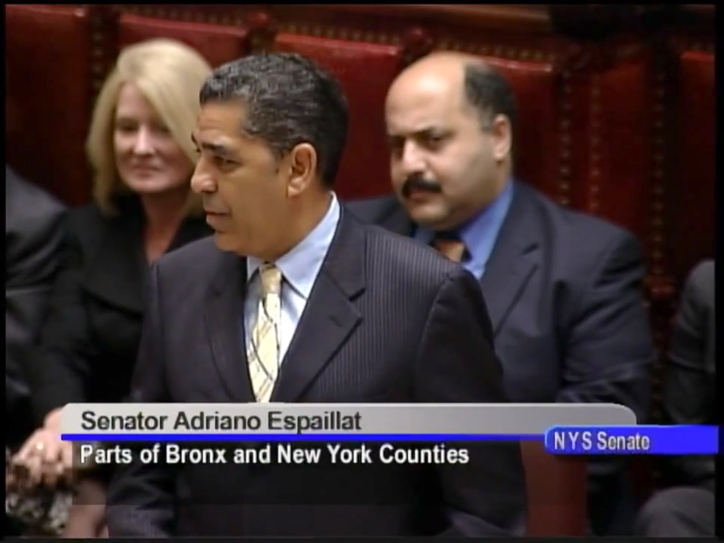

Slide 36
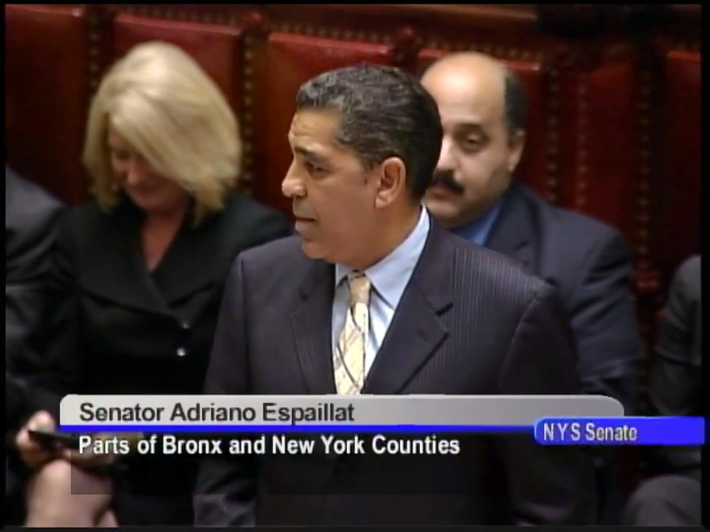

Slide 37
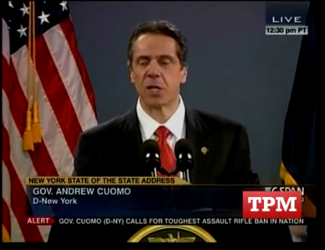

Slide 38
5th Annual NYSRPA Lobby Day and Rally
February 28, 2013
FOR MORE INFORMATION SEE:
http://www.nssf.org/share/PDF/NSSF-NY_SAFE_Act_Summary_2013-01-24.pdf

Slide 39
UPDATES
Added 10 rounds at a range to the “7 round rule.”

